Slide 1
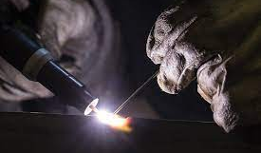


VIRTUAL REALITY
WELDING TRAINING
CODED WELDER: OFO 651202-02
KM-06: SAFELY USE, CARE AND STORE ENGINEERING HAND TOOLS, NQF LEVEL 2, CREDITS 4

Slide 2
ABOUT THIS MODULE
The main focus of the learning in this knowledge module is to safely use, care and store for a range of
engineering hand tools used for forming, cutting, marking, fastening tools, tooling aids and storing of
hand tools in a safe lock up designated area.
The learning will enable learners to demonstrate an understanding of:
KM-06-KT01: Safely use engineering hand tools. (60%)
KM-06-KT02: Apply care and maintenance of engineering hand tools. (30%)
KM-06-KT03: Store engineering hand tools in a safely designated area (10%)

Slide 3
KM-06-KT01: Safely use engineering hand tools
Topic elements to be covered include
KT0101 Demonstrate safe working practices, apply worksite practice and generic health, safety and environmental protection concepts while using engineering hand tools
KT0102 Identified, select, and safely use for all related engineering hand tools.
KT0103 Demonstrate the ability to use the different engineering hand tools in their different
applications and practice
KT0104 Recognize and report problems, changes and/or malfunctions while working with engineering hand tools

Slide 4
KT0101 Demonstrate safe working practices, apply worksite practice and generic health, safety and environmental protection concepts while using engineering hand tools
Before starting any work, welders are always advised to familiarize themself with the safety measures for each tool and machine, ensuring personal protection, colleagues, and the measuring equipment by following proper usage guidelines in the potentially hazardous work environment.
Developing responsible and safe working habits early on to prevent accidents.
Prioritizing the well-being of yourself and your colleagues, fostering a professional attitude towards your job and maintaining awareness of the working environment for a safer workplace

Slide 5
Some of the safety measures that will help you develop safe working habits:
Always wear protective footwear to prevent heavy objects injuring, ordinary shoes do not provide enough protection.
Wear a shop coat or overalls. Make sure that you roll your sleeves up or fasten the cuffs because loose clothing can get caught in moving work pieces or machines.
Wear safety glasses when you use machines portable power tools and when there is danger to your eyes. Safety glasses will stop pieces of metal or liquid from harming your eyes.
Wear a hard safety hat when you work in an area where there are overhead cranes.
Wear gloves when you move large work pieces with sharp or rough edges, or when you handle liquids that can harm your skin.
Always sweep or brush chips and shavings away from your work area. Do not handle them with your bare hands
When you work with flammable gas or liquids, make sure that there is enough ventilation in the workshop or around your workplace
Never smoke in the workshop. There are usually fumes of spilt liquids and gases in workshop can start a fire or an explosion. This can cause serious injuries or death.

Slide 6
Some of the safety measures that will help you develop safe working habits (p2):
Make sure that there are no liquid or scrap materials on the floor around your workplace.
Always have rubbish bins in particular places for the scrap materials you collect when you sweep the floors and machines.
Make sure that regular maintenance is carried out on all electrical equipment. Immediately report any faulty equipment to your supervisor.
Make sure that you know where the first – aid kit is kept
Do not run or play games in the workshop
Make sure that you have fire- fighting equipment readily available for emergencies. Check that:
The expiry date on the fire- fighting equipment has not lapsed: and
The safety seal is not broken

Slide 7
Safety measures when using hand tools: We discuss earlier, the safety measures which apply to hand tools. However, it is necessary to repeat a few of these when dealing with safety and measuring equipment: .
Use each measuring instrument for the task it is meant for.
Keep the sharp edges of tools pointed away from you, towards the back of your workbench.
Keep your measuring instruments clean, dry, and free of oil.
Take care of your tools, for example have a storage place for each hand tool / measuring instrument and service them regularly.
Never carry tools which have sharp edges in your pockets.
Keep hand files separate from rough tools, maintain a clutter-free workspace, and protect delicate tools with suitable cloth to prevent damage and ensure longevity.
Do not use your hand tools incorrectly or carelessly. Always use them for what they are intended.

Slide 8
Regulations for the metal industry
These regulations are taken from the Occupational Safety and Health Act No.85 of 1993 and apply to students from the metal industry.
1. General Duties of employees
Subject to the provisions of section 28 (1), (m), (n) and (o) of the Act, and without derogating from any specific duty imposed on an employee by the Act or the regulations, every employee shall:
Carry out any lawful order given to him and shall obey the safety rules and procedures laid down by his employer or by anyone authorized thereto by his employer, in accordance with or for the proper observance of the provisions of the Act or the regulations or in the interest of safety: and
Where a situation which is unsafe at or near his workplace comes to his attention, as soon as possible report such situation to a safety representative or to his employer.

Slide 9
Regulations for the metal industry (p2)
Ventilation, gases, and dust
No work in harmful air: If the air has visible or detectable harmful smoke, gas, fumes, or dust, no person can enter or stay there without wearing approved protective gear.
Dust in workshops: nobody can work in an area where dust, fumes, or gases exceed specified concentrations without wearing protective apparatus approved by the Director-General to prevent inhalation.
Use of compressed air: Subject to regulation 10.1.1 compressed air shall not be used:
In any way likely to cause
Disseminate of a harmful amount of dust; or
Injury to any person; or
To clean the body of person or clothes worn by him.

Slide 10
Assessment Activity
Name three ways in which you can avoid accidents with sharp or pointed tools.
Why do bench workers have accidents? Give three reasons
Give two reasons why you must wear safety shoes in a machines shop.
Why must you wear safety glasses in a machine shop? Give two reasons
Why is it safer to roll up your sleeves than to button them in a machine shop?
You must not operate a machine if its guards have been removed. Why not? Give two reasons

Slide 11
Assessment Activity (p2)
State three reasons for wearing gloves in a machine shop.
Why does oil or grease on the shop floor create a safety hazard? Give three reasons.
Why do we not leave hand tools on machines?
Regulation dealing with disobedience. What does is state?
Why do we use color codes to identify pipes in a workshop?
Name four distinct colors we use to identify different pipelines

Slide 12
KT0102 Identified, select, and safely use for all related engineering hand tools.
The selection and safe use of hand tools allow the welder to develop appropriate skills in engineering fabrication.
The skills which are derived from hand tools are cutting, forming marking off and measuring.
The following tools play an important role:

Slide 13
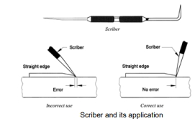
(a) Line marking techniques- Scriber
Scriber for scribing lines – is done by using a sharp and hardened tool for making thin, permanent lines accurately. This tool is called a scriber.

Slide 14
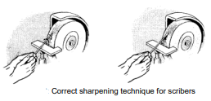
Line marking techniques- Scriber (p2)
Scriber Grinding:
Grind scriber to a point, rotating it to keep the point centered.
Exercise caution to prevent the revolving wheel from catching the point and causing injury.
Dip the blade frequently in water or wet grind to prevent overheating and maintain effectiveness.
Storage and maintenance:
Dip scriber point in rust preventive compound for a thin film.
Protect the point by inserting it into a small cork or soft wood block.
Store in a dry place, avoiding contact with metals.
Before use, wash metal parts with dry cleaning solvent to remove rust preventive compound.

Slide 15

Line marking techniques (p3) - Centre punches
These punches are made of tool steel, machined heat treated and ground to give maximum performance.
The steel body is usually knurled for finger grip, diameters range from 5-13 mm depending on the application and they have a round or square head.
Automatic centre punches are also available.
Metal fabricators use centre punches to:
Mark out patterns
Locate hole positions
Witness pop when thermal cutting.
Note Do not use a centre punch with a mushroomed head.

Slide 16
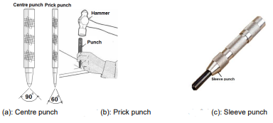
Line marking techniques (p4)- Dotting punches are also called prick punches, and a sleeve punch
The centre punch is ground to 90°. It is used to make an indentation in the surface of the workpiece to prepare for drilling a hole
The prick punch is ground with a point of 60° or even smaller and is used to witness dot scribed lines and circles. The conical impression is therefore smaller than that of the centre punch.
Sleeve punch – Fits into a sleeve and is used where the pattern is marked

Slide 17
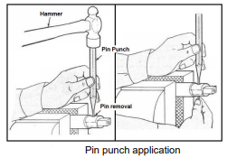
Line marking techniques(p5) - Pin Punch & Drift Punch
Pin punches are known as drift or solid punches.
They are used for the removal of axis pins, split pins, hollow tensioner pins, etc.
Pin punches are available in different diameters to suit the removal of the approximate pin diameter.
Do:
Use this tool along with a ball-peen hammer for making dimples in metal before drilling
Do not:
Use this tool for any other purpose besides centre punching
Storage Coat punches with rust preventive compound (thin film), and store in a dry place. Upon removal from storage, wash with dry cleaning solvent to remove compound.

Slide 18
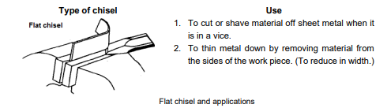
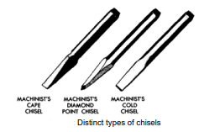
(b) Chisels - Flat chisel
Chisels for cutting metal have a hardened and tempered cutting end made of high carbon steel.
The opposite, striking end is not hardened, remaining tough and slightly flexible to prevent chipping during hammer strikes.
The striking end has a short taper to slow down the mushrooming effect caused by repeated hammer hits.
They are used with a hammer to cut metal.

Slide 19
Chisels (p2) - Caring for chisels
Before use, inspect the chisel head and cutting edge for any damage.
If the head is mushroomed, regrind it flat with a taper to the body.
Maintain Cutting Edge, Regrind a chipped or rounded cutting edge to its proper shape.
Avoid Heat Build-up when regrinding, prevent the cutting edge from getting hot to preserve hardness.
A curved or concave shape in chisels eases grinding and allows for chiseling into sharp corners.
The concave back face safeguards chisel corners and enhances maneuverability.
Remove any oil or grease from the chisel before returning it to the toolbox.

Slide 20
Chisels (p3) – Sharpening, hardening and removing mushrooms from chisels
Sharpening by grinding:
Hardening and Tempering Chisels:
Removing mushroomed end:
Choose a cutting angle of 70 degrees for general work, adjusting for material hardness, and use up to 90 degrees for hard or tough metals.
Dip the chisel frequently in water during grinding to preserve temper.
If the cutting end becomes too thick after several grindings, heat, reforge, temper, and grind the chisel.
Set the rest for the desired bevel angle, move the chisel head from side to side during grinding, and maintain equal bevel sizes for a centered cutting edge.
Heat chisel to cherry red in a gas furnace or charcoal fire.
Grasp chisel in centre with tongs. Dip cutting end in clear, cold water to a depth of about 6-8 mm. Turn chisel over and dip head end about 25mm.
Quickly polish hardened ends with a file, or aluminum oxide abrasive cloth. Watch colors return from heated centre section of chisel to ends.
Redip cutting end every time end becomes purple.
Using a chisel with a mushroomed head is dangerous; grind it back to its original shape.
Harden the chisel after removing the mushroom for proper functionality.
Tempering or burning can occur with excessive pressure during sharpening, causing heat-induced loss of hardness.
A blue or pale blue cutting edge during grinding indicates temper loss. To prevent temper loss, apply light pressure and cool the chisel frequently in water during grinding.

Slide 21
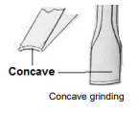
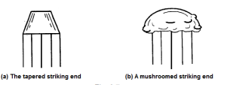
Chisels (p4) – Demonstrations

Slide 22
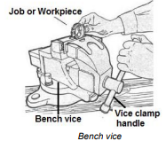
(c) Vice - Bench vice
The bench vice indicated in Figure, is used for holding workpieces so that further work may be performed (example, filing, hacksawing, tightening, mechanical strip-down of parts).
Jobs are held in a secure position to enable the mechanical process

Slide 23
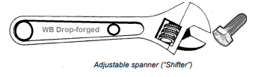
(d) Spanners
There are several types of spanners that you will use as a fitter. They are all different and have different applications. Let us now look at each of these several types of spanners in more detail.
(i) Adjustable spanners: these come in various sizes and can be adapted to fit different nut or bolt sizes.
Provide proper Adjustment which ensure the jaws are tightly adjusted against the flats of the nut to prevent slipping and rounding of corners.
It is important to use Proper Technique, when using the spanner, pull against the fixed jaw to prevent springing apart and reduce the likelihood of slipping.
Do:
Use this to turn nuts and bolts, or for small plumbing work or work with other threaded pieces.

Slide 24
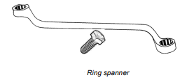
Spanners (p2)
(ii) Ring spanner: Designed to fit completely around the bolt or nut being turned.
The ring contains a series of grooves or points which engage with all the corners of the bolt or nut.
A ring spanner can be used in confined places where a flat spanner cannot be used to turn a nut.
The ring spanner must be fitted on the nut from the top, and if top space is not available it cannot be used.
Ring spanners can be either straight or offset.
This offset-type ring spanner is called a goose-neck ring spanner.

Slide 25

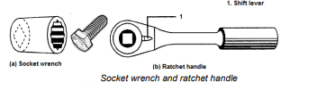

Spanners (p3)
(iii) Flay spanner: The open-ended flat spanner is used in applications where a ring spanner cannot fit over the head of the bolt or nut.
The ends of these spanners are offset at 15° to permit complete rotation of bolts and nuts in areas where space is limited by alternately flipping the spanner over. The two ends are usually made in varied sizes.
(iv) Socket wrench and ratchet handle: Set with its accessories is the most versatile of all spanners. Socket wrenches are safer and easier to use and will finish the work quicker than other spanners.
Socket Openings have a square opening for a ratchet handle and a notched circular opening to grip the bolt head or nut.
Snapping the ratchet shift lever in one direction and pulling tightens; pushing returns to starting position without removing the socket. Snapping in the opposite direction allows pushing to loosen, and pulling returns to the starting position.
(v) Extension pieces are available in different lengths and are used to reach deep down a hole or recess where other spanners cannot be used, making the socket wrench even more versatile.

Slide 26
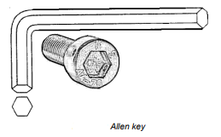
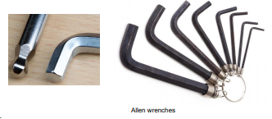
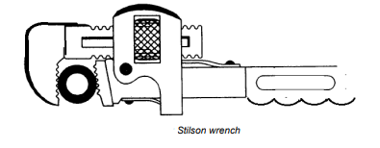
Spanners (p4)
(vi) Allen keys: Many fasteners have an internal hexagon-shaped socket to accept a wrench or key which is commonly known as an “Allen key.”
A key of the correct size must always be used to prevent rounding the corners of the key. Greatest leverage is obtained by inserting the short arm of the key into the head of the fastener. The long arm of the key can be used to reach into deep places.
(vii) Stilson wrench: Used to rotate or tighten a round work piece, example, a pipe. It has two hardened jaws with deep serrated teeth.
The outer jaw which is adjusted by a knurled or serrated nut is called the hook jaw. It is made with a small amount of play to provide an automatic and increasingly tighter grip on the round work piece when the wrench is turned in the direction of the movable jaw.
The heel jaw (which is the non-adjustable jaw) is spring-loaded to give it full floating action to increase the wrench grip.

Slide 27
Caring for spanners
Spanners should only be used for their specific purpose. Take note of the following points:
Leverage must not be increased mechanically by using a pipe or other means.
The spanners described should never be struck with a hammer. This will cause burrs and mushrooming which may later cause injuries.
Always wipe spanners clean of oil or grease to prevent them from slipping from your hand.
After completion of the work clean and store them properly.
Storage:
Coat wrenches with rust preventive compound (thin film) and store in a dry place.
Upon removal from storage, wash with dry cleaning solvent to remove rust preventive compound.

Slide 28
(e) Hacksaw
Like hammers, we can use hacksaws for many different purposes.
Understanding the different hammer parts:
The adjustable frame can be adjusted to different cutting angles which lie at angles 90° to each other. This also makes it possible for us to fit different blade lengths.
The handle is usually made from plastic or a lightweight metal such as aluminium.
We adjust the length of the frame with the adjusting screw.
We use the blade to do the actual cutting work. The blade usually has teeth which are hardened and tempered. Different blades are used to cut diverse types of materials.
There are two square pins on either side of the blade to hold the blade in place between the handle and the frame. These square pins allow the blade to fit in any of four positions.
We use the tensioning wing nut which fastens the blade to the frame to adjust the tension of the blade.

Slide 29
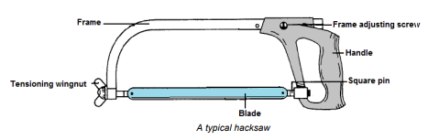
Hacksaw(p2)
The general shape of a hacksaw does not change, but we often must change the type of blade we use so that we can cut a specific material properly.
Hacksaw blades vary in length and in the size of their teeth, which we call the pitch of the teeth. This pitch is specified in mm and because the mm is a decimal unit of measurement, we call the tooth pitches metric pitches. Common pitches which are used are the 1,8mm, 1,4mm, 1,0mm and 0,8mm pitches.
Do:
Wear safety glasses
Use this to cut wood, metal, or plastic

Slide 30
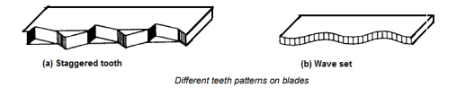
Hacksaw(p3) - Teeth patterns
The teeth of hacksaw blades are arranged, or set, in a particular pattern so that the cut which the blade makes is wider than the thickness of the blade.
This pattern makes a clearance, or space, between the teeth of the blade and the cut in the work piece. This clearance stops the blade from sticking in the cut.
You can see two types of patterns which we find on hacksaw blades (fig), shows a staggered tooth set for blades with a coarse pitch where the teeth tilt out slightly on either side. We call the pattern, a wave set, and we find this pattern on blades with a fine pitch.

Slide 31
Hacksaw(p4) - Caring for hacksaws
After you have chosen a blade, hook it onto the square pins at the end of the frame. Make sure that the teeth point away from the handle.
Tighten the tensioning wing nut to take away any looseness in the blade, in other words, to take up the slack.
Turn the tensioning wing nut through two more complete turns. This will tension the blade.
After you have made a few cuts with the blade, tighten the blade again slightly

Slide 32
Hacksaw(p5) – Types and selection of blade
Material: Soft to mild
Shape and selection Large
1,8mm: We use a coarse pitch on soft material so that there is enough space around the blade (chip clearance) to clear the cutting chips. This way we can then cut faster.
Material: Hard
Shape and selection: Large
1,4mm: The finer pitch spreads the cutting load or pressure over more teeth and still leaves enough space for chip clearance.
Material: Hard and soft
Shape and selection: Pipes, tubing and conduit
1,0mm: This fine pitch keeps two or more teeth in contact with the narrowest part of the work.
Material: Hard and Soft
Shape and selection: Unusual or thin.
0,8mm: This fine pitch
keeps two or more teeth in
contact with thin materials.

Slide 33
Hacksaw(p6) - Caring for hacksaws
When you finish using the hacksaw, wipe it clean.
Before you put the hacksaw away, loosen the tensioning wing nut to release the tension in the blade. If you leave the blade tensioned, the frame can bend.
Do not store the hacksaw in the toolbox with other tools on top of it. This can damage the hardened teeth of the blade and then the blade will cut ineffectively or stick in the cutting groove and break off.
Storage:
Apply rust preventive compound (thin film) to blades to prevent rust, and store so teeth will not be dulled by contact with other tools.
Upon removal from storage, wash metal parts with dry cleaning solvent to remove compound.

Slide 34
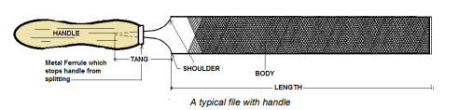
(f) Files
A file is a long flat cutting tool which has a surface covered with sharp tooth-like edges.
Used to smooth edges, remove burrs, tiny amounts of metals and shape metal objects to a, or finished, size or shape.
File handles are made from wood or plastic and are available in varied sizes to suit different types and sizes of files.
The handle should fit tightly onto the tang of the file. Once a handle has been fitted it should remain there for its entire lifespan.
Each file tooth removes a small piece of metal during cutting strokes across the workpiece. Precision filing demands patience and skill; achieving precise sizes involves applying the file with a reciprocating motion using both hands.

Slide 35
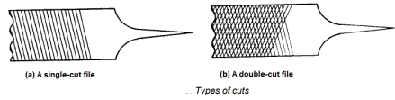
Files (p2)
Types of cuts:
Lines are cut across the surface of a file to make the teeth, they can have single-cut teeth or double-cut teeth:
If the cut lines run in only one direction, the file has single-cut teeth. We call this type of cut the first or over cut. We use single-cut files to file hard metals.
The cut lines of a double-cut file run in two directions and this is done by adding a second or up cut to the first cut. We carry out general filing work with a double-cut file.

Slide 36
Files (p3) - Grades of files
We say that a file which has only a few teeth per cm is rough or coarse, and a file which has many teeth per cm is smooth. So, the coarseness of a file depends on the number of teeth per cm.
We use the term grade to describe how coarse a file is, that is its degree of coarseness.
We will discuss three different grades of files and where we use them.

Slide 37



Files (p4) - Different grades of files and their uses
Grade | Use
 | We file iron castings and do general roughing out work to quickly remove a lot of material with the bastard grade.
 | We use a second-cut grade to rough out hard metals and to file the work piece to the size it must be.
 | We do the last filing on a work piece to finish it off to size and to give it a good finish with a smooth-cut grade. We also draw file (finishing off) with this grade

Slide 38
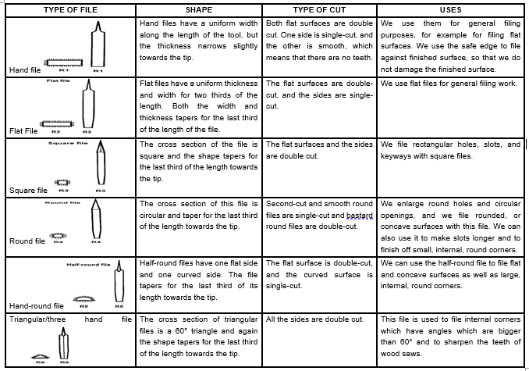
Files (p5) – Shapes for different files

Slide 39
Files (p6) – Caring for files
If using a new file on hard, rough surfaces too soon, you will break the sharp edges of the teeth. So first use a new file on soft metals like brass or bronze and if you work on mild steel, only apply light pressure on the new file. Only after using the file in this way on soft metals, you can use it on hard metals, rough surfaces of castings or welds.
Never throw or drop files onto one another because this will chip the teeth of the file.
Store files on a vertical rack or in a drawer with partitions between the files. Do not store files between other tools.
Use a file brush regularly to remove filings from the teeth and do not simply knock the file on its edge. Clean before storage.
Do not strike a file with another tool or use the file to strike something.
The tang is left soft, that is it is not hardened, and you must not use is as a lever to open lids or to lift heavy objects.
Do not use a file if it does not have a handle, or if the handle is broken, badly fitted or loose. The tang is very sharp and can cause damage

Slide 40
Files (p7) – Caring for files
Preserve sharpness of files.
Keep them in a rack. If necessary to carry files in a toolbox, wrap them individually in cloth or paper.
Keep files dry to prevent rusting.
Do not use rust preventive compound.
Do not abuse files. They are brittle and extremely dangerous if hammered or used as pry bars.
Do when using files:
Wear safety glasses and clamp your work piece to a workbench or in a vice
Hold onto the file’s handle with your dominant hand and hold onto the end of the file with your other hand
Apply moderate downward force and push the file forward on the work piece, continue using forward strokes of the file to remove material
Clean the teeth of a clogged file with a file card
Do not’s:
Use backward strokes. The teeth are angled forward and will not remove any material on backward strokes

Slide 41
Files (p8) – Caring for files
Installing handle Caution:
It is dangerous to use a file without a handle.
Select handle to fit tang. If necessary to use handle having hole too small for tang, heat same size tang of an old file and insert in handle to burn hole to proper size (snug fit).
Wet tang of file and insert it in handle. Tap back end of handle on a flat surface until file is properly seated.
Do not hammer file into the handle.
Cleaning Files:
The cutting action of a file produces small particles or chips called filings. These particles frequently wedge between the teeth of file and impair the free cutting action. Frequent cleaning is necessary to obtain maximum efficiency of file.
Brush filings from between teeth of file with file card or wire brush. Push brush in a direction parallel with teeth.
Storage:
Be sure files and rasps are clean and dry.
Do not use lubricants or rust preventive compounds. Wrap them individually in waterproof barrier wrapping paper.
Place in racks or box in a manner which will make it impossible for faces or edges of files to contact each other.

Slide 42
(g) Pliers
Used to grip, cut, bend, and form small pieces of sheet metal or wire and to hold fasteners.
There are many distinct types and sizes of pliers, but we will only discuss general purpose, or side cutting, long nose, pipe, and circlip pliers here.
Avoid using pliers as a substitute for a spanner.
Pliers with cutters will deform or break if the tool is used to cut metal sizes that are too large, or work that has been heat-treated. Breakage will also occur if additional leverage is applied to the handles.
Clean and oil pliers occasionally.
Store pliers in a clean, dry place. Avoid throwing them in a drawer or toolbox with other tools

Slide 43
Pliers (p2) – types
General purpose pliers
The other name for general purpose pliers is side cutting pliers and these have side cutters to cut wire with. We use general purpose pliers to grip small cylindrical or flat sheet metal work pieces. We also use them to bend wire and thin sheet metal.
Long nose pliers
Long nose pliers are used for reaching into tight corners during mechanical assembly, to form wire loops and for the removal of split pins.
Pipe pliers
Pipe pliers, also known as gas pliers, are used for gripping cylindrical work such as pipes and tubes. It is possible to adjust the position of the jaws relative to one another by sliding one over the other.

Slide 44
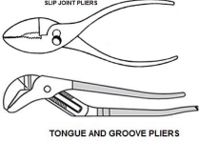
Pliers (p3) - Slip-joint pliers
Straight slip joint pliers are configured similarly to common or lineman's pliers in that their jaws are in line with their handles.
One side of the pliers usually has two holes that connect by a slot for the pivot. The pivot is fastened to the other side and shaped such that it can slide through the slot when the pliers are opened.
Tongue-and-groove pliers - also known as water pump pliers, adjustable pliers, groove joint pliers, Multi-Grips, and Channel locks, are a type of slip-joint pliers.
They have serrated jaws set 45° to 60° from the handles. The lower jaw can be moved to several positions by sliding along a tracking section under the upper jaw.
An advantage of this design is that the pliers can adjust to several sizes without the distance in the handle growing wider. These pliers often have long handles—commonly 250 mm to 300 mm long—for increased leverage.
Tongue-and-groove pliers are commonly used for turning and holding nuts and bolts, gripping irregularly shaped objects, and clamping materials.

Slide 45
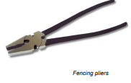
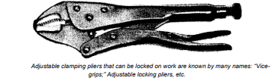

Pliers (p4) - Caring for pliers
Use pliers for their intended purpose, keep them clean, and periodically apply a drop of light oil to the pivot point for smooth operation.
Other types of pliers:

Slide 46
Pliers (p5) - Caring for pliers
Grinding and Sharpening Note: Many modern side cutting pliers and all nippers are designed so they can be reground. Some older models will not close if material is ground from cutting edges.
Examine pliers to see if design will permit them to close completely if material is ground from cutting edges. Do not attempt to sharpen pliers not designed to be ground.
Grind cutting edges so ground bevel is at right angles with inside machined bevel. Grind same amount of stock from both jaws but no more than necessary to remove nicks. Cool often in water to preserve temper
Cleaning Wash pliers in dry cleaning solvent and wipe dry with a clean cloth. Clean dirt from serrated jaw faces with a wire brush. When completely dry, lubricate pivot pin with one or two drops of preservative lubricating oil (special) or engine oil (SAE 10).

Slide 47
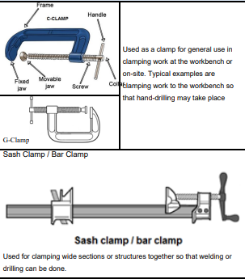
(h) Clamps
Essential for holding and securing workpieces in place during welding operations.
There are various types of welding clamps designed for specific applications.
These are heavy-duty but simple tools. Maintenance requirements are few:
Keep screws lubricated with a small amount of preventive lubricating oil or SAE 10 engine oil.
Avoid excessive lubricant to prevent interference with tool use; keep metal surfaces rust-free.
Remove rust or corrosion with crocus cloth or aluminum oxide abrasive cloth. Coat surfaces with preservative lubricating oil or light engine oil.
Replace all parts broken or damaged beyond repair for optimal tool functionality.

Slide 48


(h) Clamps (p2)
Replace C-Clamp Screw or Jaw
Pry open crimped portion of swivel head and remove head from ball on end of screw. Turn the screw out of the jaw.
Using new parts as needed, turn the screw into position through its boss at end of jaw. Slip swivel head onto ball on end of screw and crimp head sufficiently to hold it on ball.
Replace Handle on Hand Screw Clamp.
File off peened ends of pin which attaches handle to screw.
Drive out pin. Unscrew or drive handle from screw.
Screw new handle in position on screw with pinholes in handle and in screw aligned. Tap in and peen pin.
Storage:
Coat clamps with rust preventive compound (thin film) and store in a dry place. After removal from storage, wash metal parts with dry cleaning solvent to remove rust preventive compound.

Slide 49
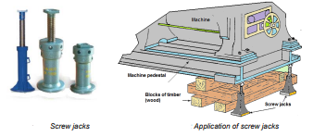
(i) Jacks
Used to lift equipment and are differentiated into three categories:
(i) Screw Jacks:
Screw jacks are one of the oldest types of jacks, known for their mechanical operation and reliability. Consist of body, screwed spindle, and swivel head.
Lifting is accomplished by screwing out the spindle, using a rod inserted through holes in the head. Clockwise rotation raises the load, while counterclockwise lowers it.
Screw jacks may twist under heavy loads, causing the floating head to bind.

Slide 50
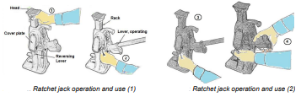
Jacks (p2)
(ii) Ratchet jacks:
Operated by means of a reversible ratchet mechanism and are very handy for re-railing derailed rolling stock.
The operator should familiarize himself with the jack, its capabilities, and its operations.
The reversing lever is located below the lifting mechanism cover on the left side of jack when viewed from the lifting lever. When preparing to lift a load, the head can be pulled up by hand to meet the load.

Slide 51
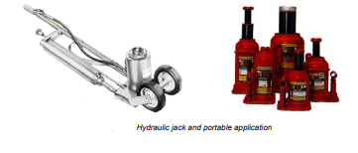
Jacks (p3)
(iii) Hydraulic jack
hydraulic fluid under pressure being used to move a piston. Hydraulic jacks are used as hydraulic presses and for lifting heavy loads
A hydraulic jack which leaks oil should be taken out of service and repaired. Hydraulic jacks may settle after raising a load. It is therefore important not to allow the load to remain supported only by the jacks, but to employ blocking as soon as the load has been raised. After a jack has been repaired, it should be tested thoroughly before it is to be used.

Slide 52
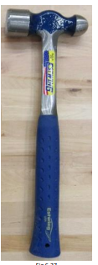
(j) Ball pein hammer
The head is made of heat treated forged high carbon steel that is harder than a claw hammer.
The round “peening” end is used less in metalworking than it used to be, but it is meant to work and shape malleable metals.
Do:
Wear safety glasses and always hold onto the rubber grip with your dominant hand
Place your work piece on a hard surface
Check your surroundings to make sure you won’t hit anyone when you swing the hammer. Always swing with your whole arm and elbow
Hit your work piece squarely with the head of the hammer
Use this tool to strike punches and chisels and to peen and form sheet metal
Do not:
Strike with the sides, top or bottom of the hammer
Use this tool to strike nails

Slide 53
(j) Ball pein hammer (p2)
Care of hammers:
Prevent rust formation, carefully wiping steel hammer heads dry after exposure to moisture.
When it is known in advance that tool will be exposed to moisture, spread a film of lubricating oil. Frequently inspect hammer type tools to see if handle is tight in head and to see if face is in satisfactory condition.
Tightening Handle If wedge comes loose, remove it, and install larger wedge. If wedge remains tight in handle. If unable to tighten, replace handle.
Grinding Face Incorrect or abusive use of hammer type tools frequently results in uneven face wear. To reshape worn faces:
Storage:
Coat steel heads with rust preventive compound (thin film) and store in a dry place.
Upon removal from storage, wash metal parts with dry cleaning solvent to remove rust preventive compound.

Slide 54
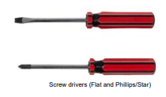
(k) Screwdrivers
A screwdriver is a hand-tool for turning (driving) screws (and sometimes bolts or other machine elements with a mating drive system.
A screwdriver is identified by its tip, which is shaped to fit, or mate with, a screw the head of which has a particular contour, or surface shape.
A screwdriver is, thus, a mechanism to apply torque to a screw.
Do:
Flat - Use this tool to install and remove flat-head screws and bolts
Philips/Star - A screwdriver will be easy to identify by its “star-shaped” tip, which is shaped to fit, or mate with, a screw the head
Storage Spread rust preventive compound (thin film) over metal parts of screwdrivers, and store in a dry place. Upon removal from storage, wash metal parts with dry cleaning solvent to remove rust preventive compound.

Slide 55
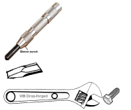
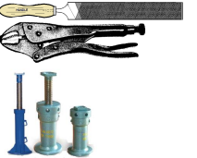
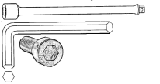

Assessment Activity
Briefly explain ONE unacceptable practice when dealing with the hand tools : (i) Hand files (ii)Centre punch (iii) Spanners (iv) Hammer (v) Screwdriver.
Briefly state the name of the hand tool and describe its application.

Slide 56

Assessment Activity (p2)
List FIVE types of marking out tools
List THREE of the safety precautions to be observed when using marking out tools.
List TWO of the safety precautions to be observed when using the following tools. Snips, vices, Files
State the name of the SIX parts of the file drawn below:

Slide 57
KT0203 Procedures and technique for cleaning different engineering hand tools
After completing this topic, you the learner will be able to demonstrate an understanding of:
6.3.1 KT0301 Engineering hand tools are stored as per storage management specifications
6.3.2 KT0302 Safely store different hand tools according to their classifications
6.3.3 KT0303 Store engineering hand tools in a lock up safely designated area
6.3.4 KT0304 Procedures for storing different hand tools
6.3.5 KT0305 Safety inspection and records of stored engineering hand tools are administered
6.3.6 KT0306 Recognize and report problems, changes and/or malfunctions while storing engineering hand tools

Slide 58
KT0301 Engineering hand tools are stored as per storage management specifications
Material handling includes tasks like crane hoisting, truck driving, manual carrying, and pallet stacking, crucial for industry.
Efficient material handling ensures a steady flow of tools and equipment, maintaining their availability.
Improper material handling often results in expensive injuries, underscoring the importance of proper procedures.
Workplace Safety Measures:
Applying general safety principles, including proper work practices, equipment usage, and controls, alongside training and education, is crucial to reducing workplace accidents related to moving, handling, and storing materials.
Employees, whether manually or mechanically moving materials, must be aware of potential hazards and know how to control their workplaces to minimize danger.

Slide 59
KT0302 Safely store different hand tools according to their classifications
Store instruments in an appropriate location that ensures an optimum environment, avoiding wet or damaging conditions.
Prevent precision tools from banging against each other or hitting storage surfaces by arranging them carefully or using well-padded cases.
Refrain from stacking or arranging instruments on top of each other unless placed in protective cases to prevent damage.
Keep measuring instruments away from unavoidable vibrations to prevent calibration issues.
Reduce humidity in damp storage with methods like silica gel packs or air conditioning; consider a dehumidifier for extreme cases.
Workers should recognize and minimize risks from improper material handling, equipment use, and work practices; employers must identify and correct unsafe workplace conditions.

Slide 60
KT0303 Store engineering hand tools in a lock up safely designated area - Criteria for a safely designated area
Employers should make a dedicated space available – for a storeroom for the storage of tools, measuring equipment and consumables.
The storeroom should have shelving and fixtures for the safe storage and issuing to workers of all tools, equipment, and consumables.
The store should be staffed by a suitably qualified person/persons - trained to conduct storekeeping activities.
An administration system must be developed which allows for the documenting of all tools issued to - and all tools returned by workers.
Company policy must be established for the control of new tool/equipment purchases, equipment redundancies, decommissioning and re-issuance procedures.

Slide 61
KT0304 Procedures for storing different hand tools
Proper storage ensures easy access to commonly used welding tools, reducing time wasted in finding the right tool for the job.
Implementing a systematic storekeeping approach safeguards tools and equipment, preventing theft and ensuring asset security.
Proper storage involves classifying tools into groups, facilitating easy identification for fellow workers and promoting efficient tool retrieval.
Examples of tool classifications include striking tools, deburring tools, abrasive tools, measuring and leveling tools, inspection tools, marking off tools, jigs and fixtures, cutting tools, pliers, and wrenches (spanners).

Slide 62
KT0304 Procedures for storing different hand tools (p2) - Storekeeping procedures
The storeroom of a fabrication and welding workshop will meet the following criteria for safe and proper storage of all tools and equipment:
Adequate staffing with dedicated personnel responsible for:
Maintaining proper records of issued and outstanding tools.
Ensuring safe storage and use of tools and equipment.
Conducting regular maintenance and arranging speedy repairs.
Identifying the need for replacements and reordering defective items.
Performing regular stocktaking to monitor losses.
Liaising with sales representatives to prepare a budget for equipment replacement.

Slide 63
KT0305 Safety inspection and records of stored engineering hand tools are administered
Factors for administration of safety inspections and records
Applications of different hand tools in a general engineering context
Common faults and/or defects in hand tools
Procedures for marking unsafe or faulty tools for repair routine maintenance requirements for a range of hand tools storage location.
Procedures for a range of hand tools hazards and control measures associated with using hand tools use
Application of personal protective equipment (PPE)

Slide 64
KT0306 Recognize and report problems, changes and/or malfunctions while storing engineering hand tools.
Storing Instruments in the Appropriate Location:
Store instruments in an environment suitable for their preservation, avoiding wet or damaging locations.
Prevent precision tools from banging against each other or storage surfaces by arranging them carefully or using well-padded cases.
Refrain from stacking instruments unless placed in protective cases to prevent damage.
If unavoidable vibrations are present, keep measuring instruments away to prevent potential calibration issues.
Address damp storage by reducing humidity with methods like silica gel packs, air conditioning, or using a dehumidifier for extreme cases.

Slide 65

The End

